Slide 1
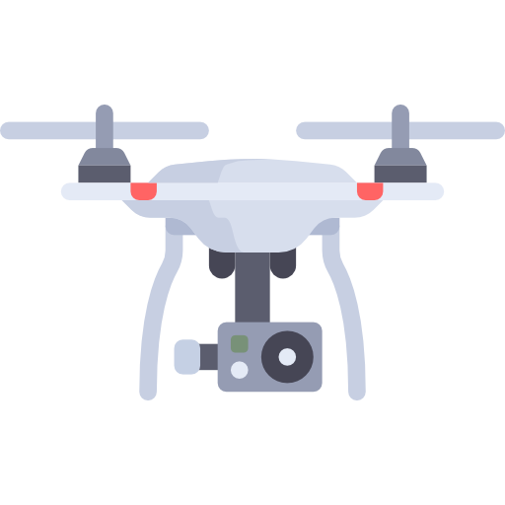
Fire - Fighter Drone

Slide 2
Team Members
Alpha-Titans
Tarun Sanjeev S CB.EN.U4AIE19064
Dharshan Kumar K S CB.EN.U4AIE19024
Arun Prakash J CB.EN.U4AIE19014

Slide 3
The Inspiration
1
That inspired us to work on this project

Slide 4
There has been a rise in the amount of environmental crisis that occur every year.
Over the past few years, fire accidents has become a very common threat, increasing the number of burn injuries and death tolls.
The fire department has done a great job in keeping the trend static and decreasing it. However, a few more additions can be made to make their job easier.
Fire accidents happen in a matter of seconds. Each second is important to save life caught in a fire accident. Our main aim is to make their work more efficient using drones.

Slide 5
The Design
2
That helps combine AI with Fire Fighting

Slide 6
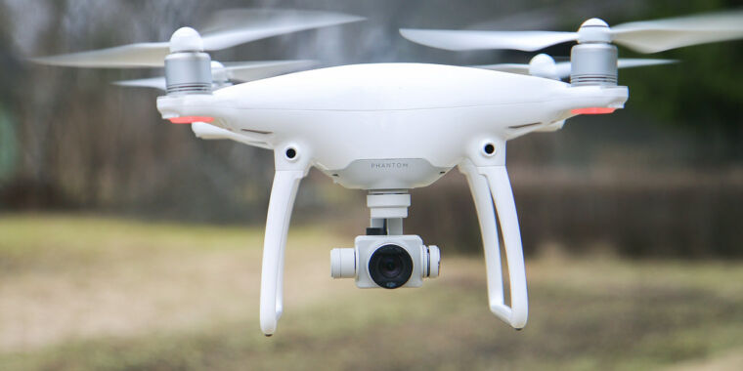
Drones when equipped with object detection algorithm in addition to thermal cameras and temperature sensors will save a huge deal of time.
The camera detects the number of people trapped in a particular location, detects the temperature and sends the info directly to the fire dept.

Slide 7
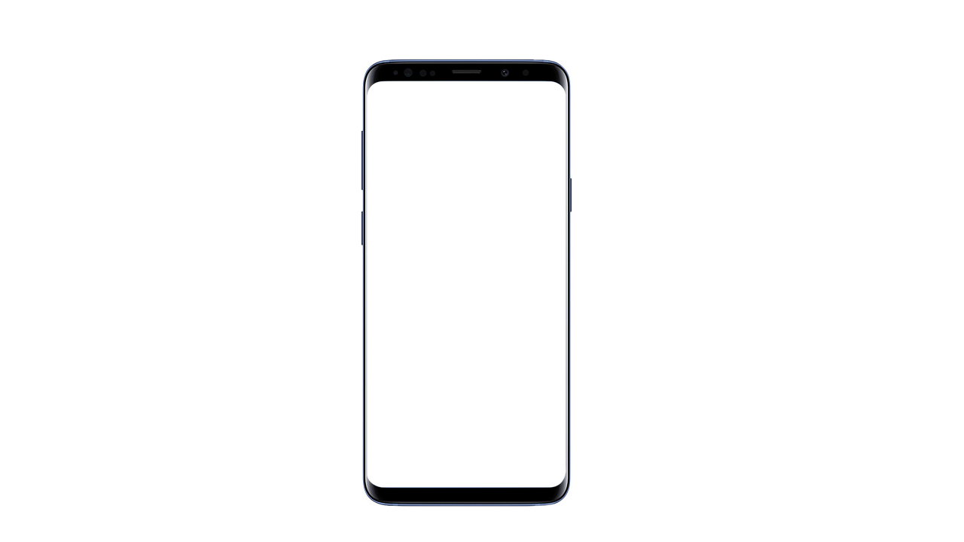
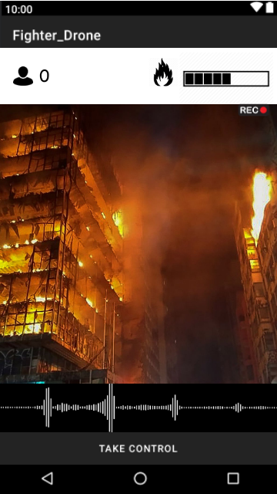

Slide 8
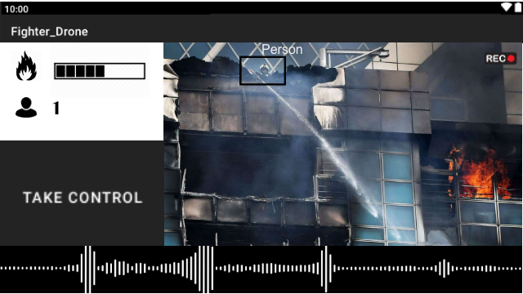
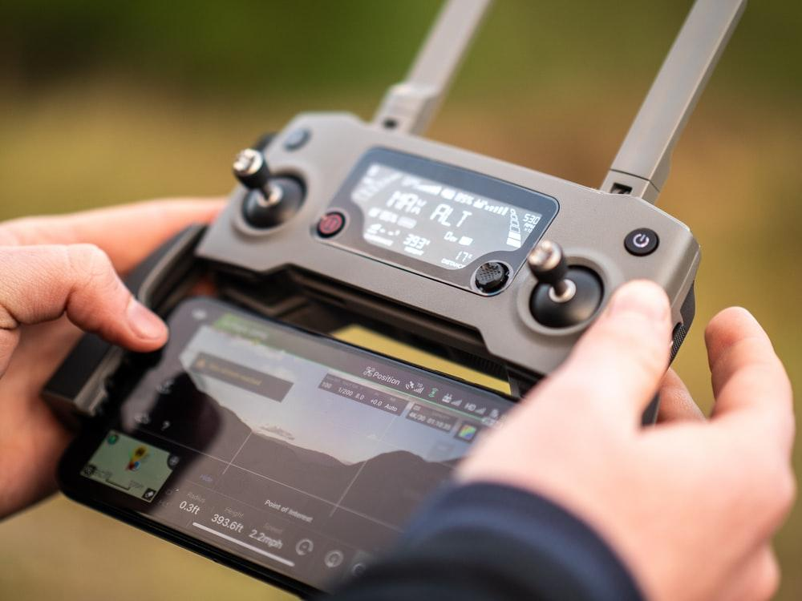
Connect Mobile with Drone controller for Manual Control

Slide 9
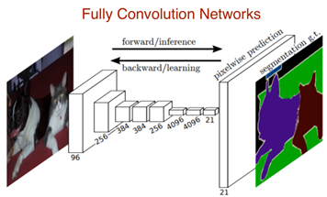
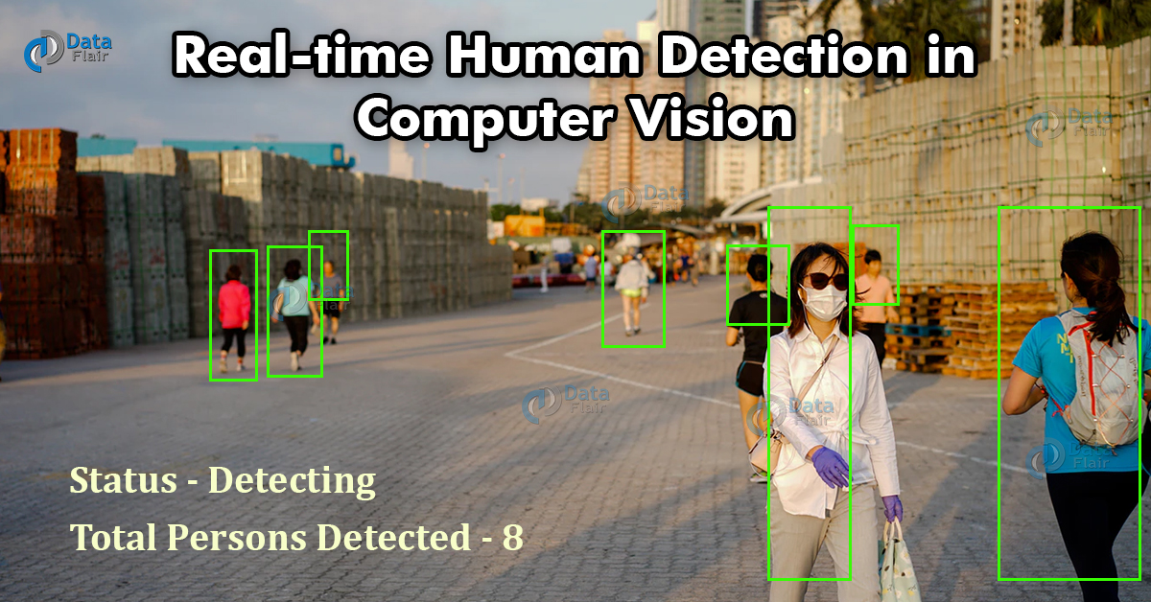
Object Detection
Algorithms
YOLO-v4
RCNN
Seg-Net
U-Net

Slide 10
Implementation of the Idea
3
Putting it to work

Slide 11
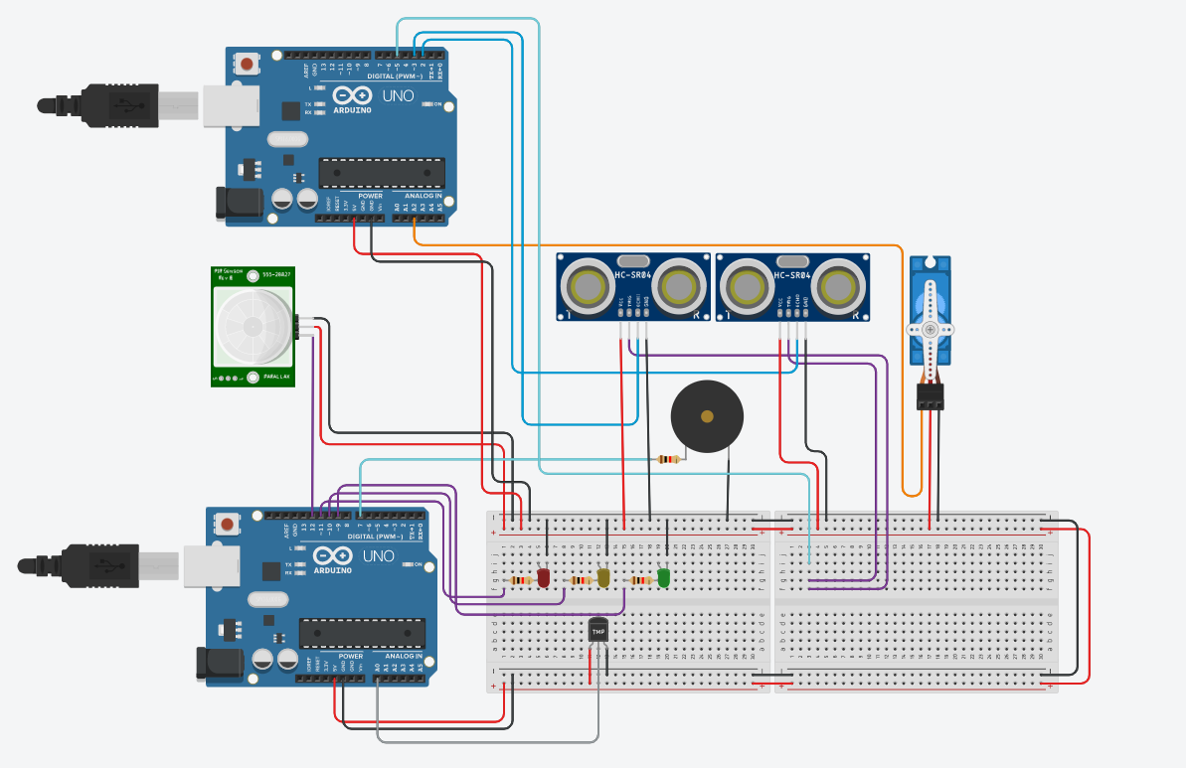

Slide 12
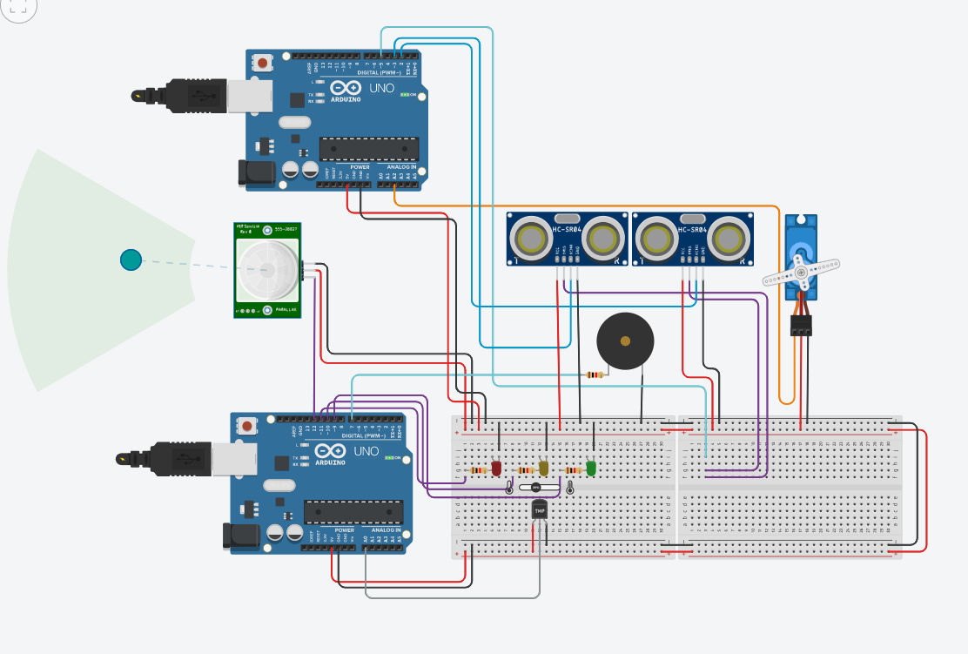

Slide 13
The Code
4
Simulating the Implemented Work

Slide 14
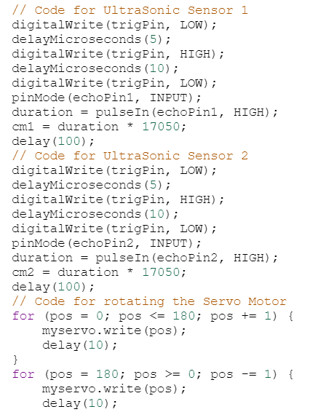
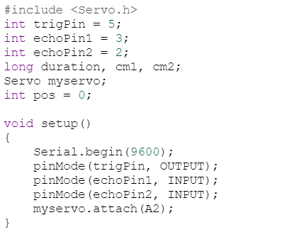

Slide 15
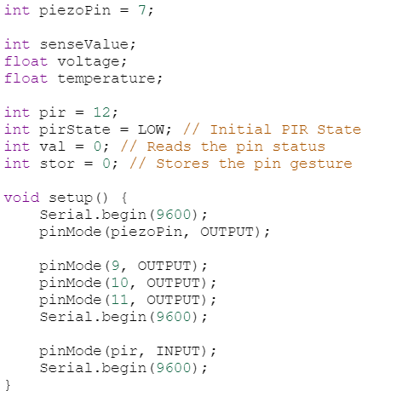
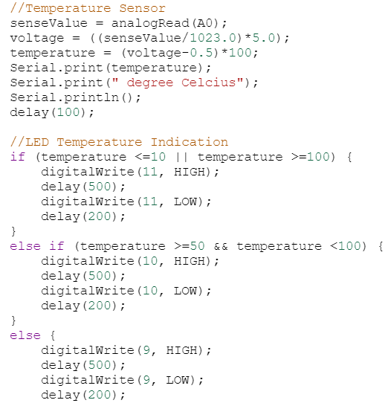

Slide 16
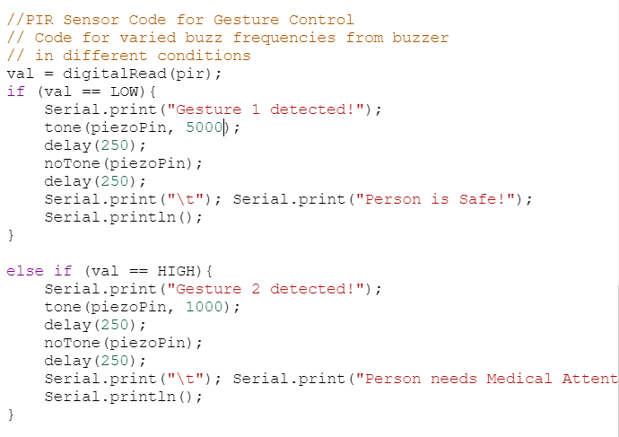

Slide 17
Future Scope and Improvements
5
Creating a better future

Slide 18
This Drone is a prototype model that can be improved a lot in the future.
It can be modified and fitted with different components according to the situation’s need.
Not only for helping people in need but can also be programmed to assist people in their daily tasks.

Slide 19
THANK YOU

